Slide 1
Interrupts in Microcontroller

Slide 2
Interrupt
An interrupt is an external or internal event that interrupts the microcontroller to inform it that a device needs its service
A single microcontroller can serve several devices by two ways Interrupts.
Whenever any device needs its service, the device notifies the microcontroller by sending it an interrupt signal
Upon receiving an interrupt signal, the microcontroller interrupts whatever it is doing and serves the device
The program which is associated with the interrupt is called the interrupt service routine (ISR) or interrupt handler.

Slide 3
Polling
The microcontroller continuously monitors the status of a given device
When the conditions met, it performs the service After that, it moves on to monitor the next device until every one is serviced.

Slide 4
Enabling and Disabling an Interrupt
Upon Reset, all the interrupts are disabled even if they are activated.
The interrupts must be enabled using software in order for
the microcontroller to respond to those interrupts.
IE (interrupt enable)
register is responsible for enabling and disabling the interrupt.
IE is a bitaddressable register.
Interrupt Enable Register
EA − Global enable/disable.
- − Undefined.
ET2 − Enable Timer 2 interrupt.
ES − Enable Serial port interrupt.
ET1 − Enable Timer 1 interrupt.
EX1 − Enable External 1 interrupt.
ET0 − Enable Timer 0 interrupt.
EX0 − Enable External 0 interrupt.
EA | - | ET2 | ES | ET1 | EX1 | ET0 | EX0

Slide 5
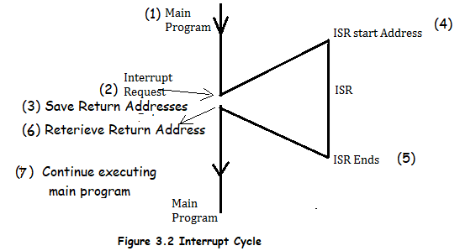
Interrupt service routine
For every interrupt, there must be an interrupt service routine (ISR), or interrupt handler
When an interrupt is invoked, the microcontroller runs the interrupt service Routine
For every interrupt, there is a fixed location in memory that holds the address of its ISR
The group of memory locations set aside to hold the addresses of ISRs is called interrupt vector table

Slide 6
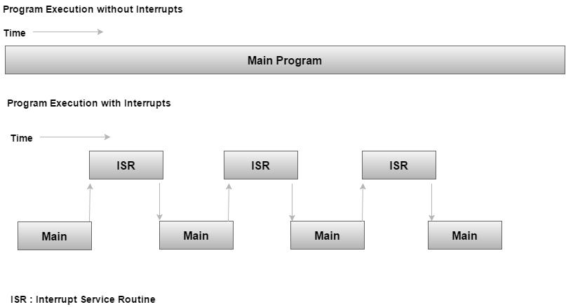
Interrupt service routine

Slide 7
Interrupt Vector Table
Six interrupts are allocated as follows
Reset – power-up reset
Two interrupts are set aside for the timers: one for timer 0 and one for timer 1
Two interrupts are set aside for hardware external interrupts
P3.2 and P3.3 are for the external hardware
interrupts INT0 (or EX1), and INT1 (or EX2)
Serial communication has a single interrupt that belongs to both receive and transfer
Interrupts | ROM Location (Hex) | Pin
Interrupts | ROM Location (HEX)
Serial COM (RI and TI) | 0023
Timer 1 interrupts(TF1) | 001B
External HW interrupt 1 (INT1) | 0013 | P3.3 (13)
External HW interrupt 0 (INT0) | 0003 | P3.2 (12)
Timer 0 (TF0) | 000B
Reset | 0000 | 9

Slide 8
Interrupt vector Table
When the reset pin is activated, the 8051 jumps to the address location 0000. This is power-up reset.
Two interrupts are set aside for the timers: one for timer 0 and one for timer 1. Memory locations are 000BH and 001BH respectively in the interrupt vector table.
Two interrupts are set aside for hardware external interrupts. Pin no. 12 and Pin no. 13 in Port 3 are for the external hardware interrupts INT0 and INT1, respectively. Memory locations are 0003H and 0013H respectively in the interrupt vector table.
Serial communication has a single interrupt that belongs to both receive and transmit. Memory location 0023H belongs to this interrupt.

Slide 9
Steps to Execute an Interrupt
The microcontroller closes the currently executing instruction and saves the address of the next instruction (PC) on the stack.
It also saves the current status of all the interrupts internally (i.e., not on the stack).
It jumps to the memory location of the interrupt vector table that holds the address of the interrupts service routine.
The microcontroller gets the address of the ISR from the interrupt vector table and jumps to it. It starts to execute the interrupt service subroutine, which is RETI (return from interrupt).
Upon executing the RETI instruction, the microcontroller returns to the location where it was interrupted. First, it gets the program counter (PC) address from the stack by popping the top bytes of the stack into the PC. Then, it start to execute from that address.

Slide 10
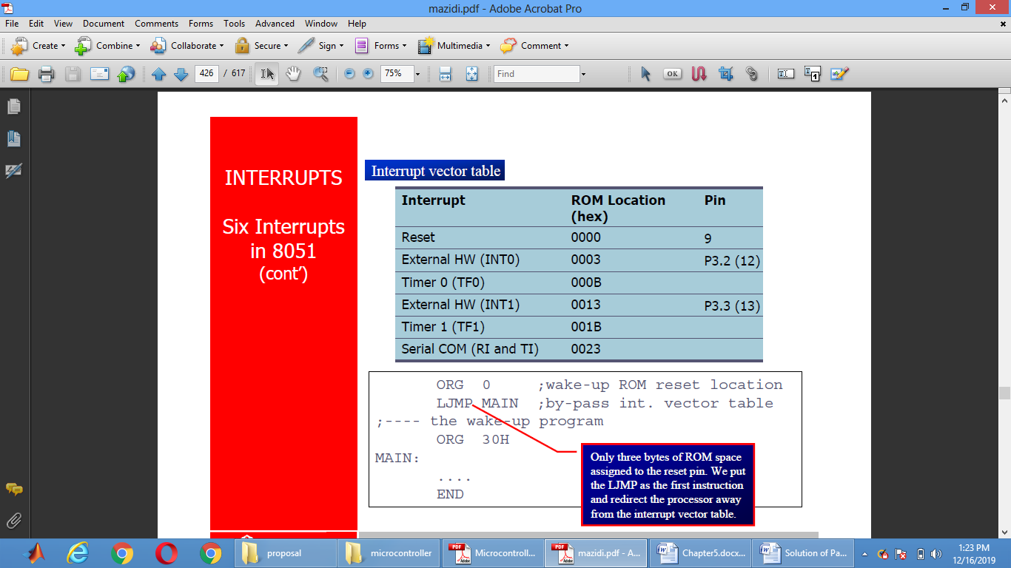

Slide 11
Interrupt priority
We can alter the interrupt priority by assigning the higher priority to any one of the interrupts. This is accomplished by programming a register called IP (interrupt priority).
- | IP.7 | Not Implemented.
- | IP.6 | Not Implemented.
- | IP.5 | Not Implemented.
- | IP.4 | Not Implemented.
PT1 | IP.3 | Defines the Timer 1 interrupt priority level.
PX1 | IP.2 | Defines the External Interrupt 1 priority level.
PT0 | IP.1 | Defines the Timer 0 interrupt priority level.
PX0 | IP.0 | Defines the External Interrupt 0 priority level.

Slide 12
Interrupts Pin in Arduino pin(2,3)
#define LED_PIN 9
#define BUTTON_PIN 3
byte ledState = LOW;
void setup() {
pinMode(LED_PIN, OUTPUT);
pinMode(BUTTON_PIN, INPUT);
}
void loop() {
if (digitalRead(BUTTON_PIN), HIGH) {
ledState = !ledState;
}
digitalWrite(LED_PIN, ledState);
}

Slide 13
